Slide 1
TCP on Tokamak Programmes
Duarte Borba
on Behalf of Richard Pitts ITER Organization
Chair, Executive Committee February 18, 2016

Slide 2
Outline
Aims of the TCP and key achievements
A description of TCP participants
Current work programme
Priorities for future work
Governance structure
Outreach and communication activities
Example of cooperation

Slide 3
Aims of the CTP-TCP and key achievements
The objective of this TCP is to enhance the scientific and technological achievements of the Tokamak Programmes by means of co-operative actions for the advancement of the Tokamak concept.
The CTP-TCP is one of the largest among the fusion TCPs under the IEA. In 2015, the tokamaks involved in this TCP have continued to provide essential input to the ITER physics basis and to the reinforcement and consolidation of the ITER Research Plan

Slide 4
Description of TCP participants
European Atomic Energy Community (Euratom), European Union
Japan Atomic Energy Agency (JAEA), Japan
United States Department Of Energy (USDOE), United States
The Korean Ministry of Education, Science And Technology (MEST), Korea.
The Institute For Plasma Research (IPR), India.
ITER International Organization
ITER China Domestic Agency (CN-DA)

Slide 5
Description of TCP participants
Cooperation on large tokamaks started as the "Implementing Agreement on Cooperation among the three large Tokamak facilities (JET, JT-60 and TFTR)" in Feb.19, 1986
Participation of the Government of Korea as a Contracting Party in this Agreement became effective as of 5 February 2010
Participation of the Institute for Plasma Research, India, in this Agreement became effective as of 11 April 2011.
Participation of ITER as a Contracting Party in the CTP-IA became effective as of 20 October 2012.
Participation of ITER China Domestic Agency (CN-DA) as a Contracting Party in the CTP-IA became effective as of 16 January 2013.

Slide 6
TCP’s current programme of work.
Although not the only vehicle for information exchange under the CTP-TCP, the International Tokamak Physics Activity (ITPA) has become a key player in the years since ITPA Coordination has been assumed by the ITER Organization
ITPA activities now strongly focused on ITER priorities and coordinated by the IO
The 7 ITPA Topical Groups together cover all the priority physics areas
Activities are coordinated during the following annual workshops and meetings: International Tokamak Physics Activities (ITPA) Joint Experiments Workshop (JEX) and Meeting of the ITPA Coordinating Committee.

Slide 7
ITPA Joint Experiments for 2016
Summary of ongoing and new Topical Group proposals
Topical Group | 2015 continue | 2016 new | 2016 total | 2016 ITER Priority 1
Divertor & SOL | 7 | 3 | 10 | 2
Diagnostics | 7 | 1 | 8 | 3
Pedestal | 6 | 1 | 7 | 1
Energetic particles | 2 | 3 | 5 | 1
Integrated Operational Scenarios | 8 | 1 | 9 | 1
MHD Stability | 11 | 2 | 13 | 4
Transport & Confinement | 12 | 1 | 13 | 4
Total | 53 | 12 | 65 | 16

Slide 8
TCP’s current programme of work 2015 personnel exchanges
Wide range of bilateral and multi-lateral collaborations in 2015:
EU – US: 6 Exchanges, 90 ppd
IO – EU: 4 Exchanges, 11 ppd
(participation of ITER personnel on the JET Programme)
IO – KO: 2 Exchanges, 9 ppd
JA – EU: 2 Exchanges, 1 ppy, 4 ppd
JA – US: 4 Exchanges, 32 ppd
KO – EU: 2 Exchanges, 51 ppd
KO – IO: 1 Exchanges, 5 ppd
US – EU: 7 Exchanges, 65 ppd
US – KO: 10 Exchanges, 264 ppd
Many other exchanges took place under bilateral agreements

Slide 9
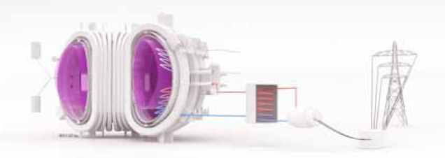
Priorities for future work
Gaps to Fusion Energy
Sustainment of high gain burning plasma
Control of burning plasma, long duration, heat exhaust
Materials resistant to high heat fluxes and neutron fluence
Tritium cycle & T self-sufficiency
~112kg T/year for 500MWe reactor
Efficient breeding and extraction

Slide 10
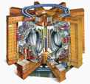
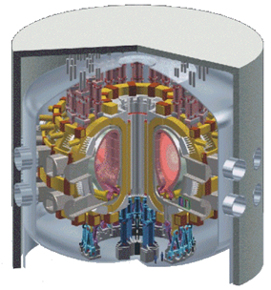
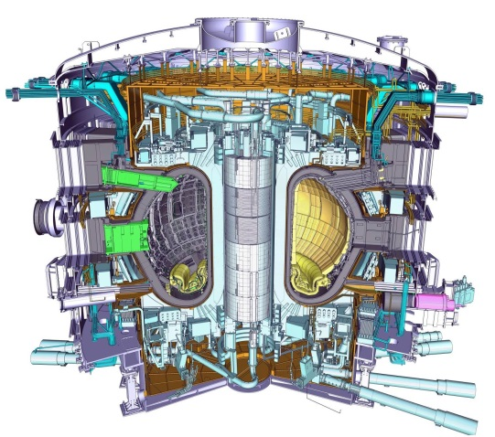
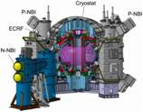
Priorities for future work
Support ITER construction and optimise ITER operation
ITER
800 m³
~ 500 MW_{th}
DEMO
~ 1000 - 3500 m³
~ 2000 - 4000 MW_{th}
JET, JT60-SA and many tokamaks worldwide

Slide 11
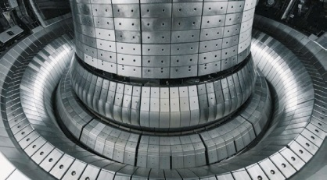
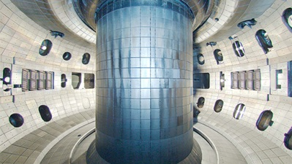
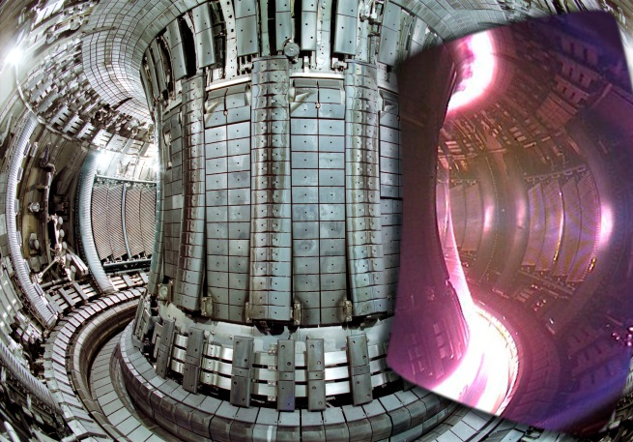
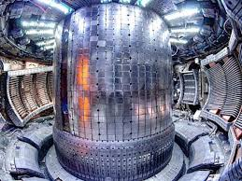
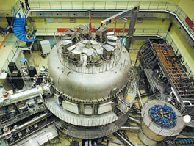
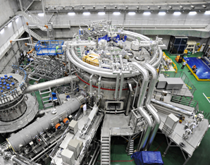
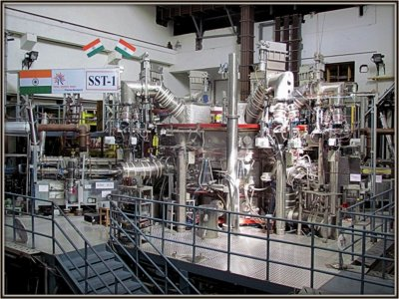
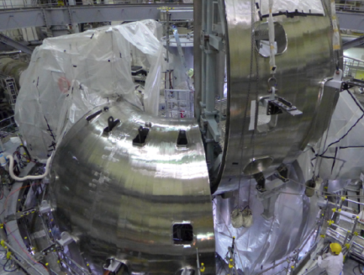
Priorities for future work
ITER: the biggest in a long line of Tokamaks
ITER builds on nearly 50 years of worldwide tokamak research on more than 150 devices, the largest currently operating, JET, which began operation in 1983 is still operating
JET, EU
ASDEX-U, EU
DIII-D, US
~8 m
NSTX, US TCV, EU MAST, EU CMOD, US
Superconducting devices operating or planned in Asia/India
EAST, China
KSTAR, S. Korea
SST-1, India
JT60-SA, Japan

Slide 12
Priorities for future work
Fusion gain and the ITER tokamak
Fusion energy gain
Break even
Q = 1 | f_{α} = 17%
Q = 5 | f_{α} = 50%
Q = 10 | f_{α} = 67%
Q = 20 | f_{α} = 80%
Q = ∞ | f_{α} = 100%
Burning plasma regime
α-heating fraction
The JET and TFTR tokamaks have produced DT fusion powers >10MW for ~1s in the 1990’s (Q ~0.5)
ITER is designed to a scale which should yield Q ≥ 10 at a fusion power of 400 – 500 MW for 300 – 500 s
Alternative scenarios also planned at lower Q but longer pulse (up to 1 hour)
Notes:
In nuclear fusion research, the Lawson criterion, first derived on fusion reactors (initially classified) by John D. Lawson in 1955 and published in 1957,^{[1]} is an important general measure of a system that defines the conditions needed for a fusion reactor to reach ignition, that is, that the heating of the plasma by the products of the fusion reactions is sufficient to maintain the temperature of the plasma against all losses without external power input. As originally formulated the Lawson criterion gives a minimum required value for the product of the plasma (electron) density n_{e} and the "energy confinement time" . Later analysis suggested that a more useful figure of merit is the "triple product" of density, confinement time, and plasma temperature T. The triple product also has a minimum required value, and the name "Lawson criterion" often refers to this inequality.

Slide 13
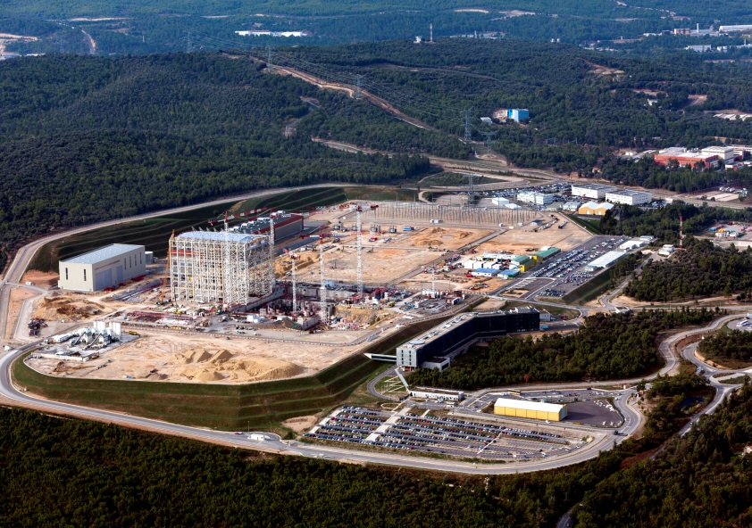
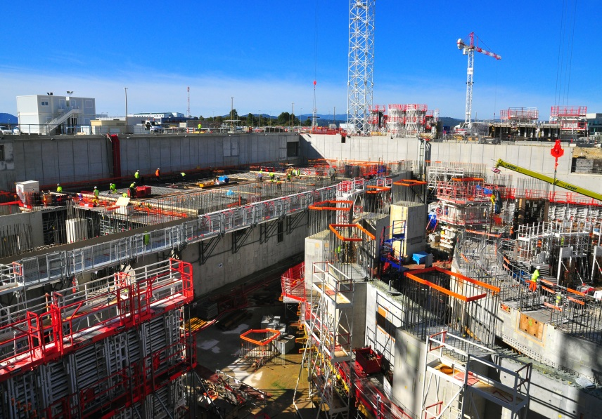
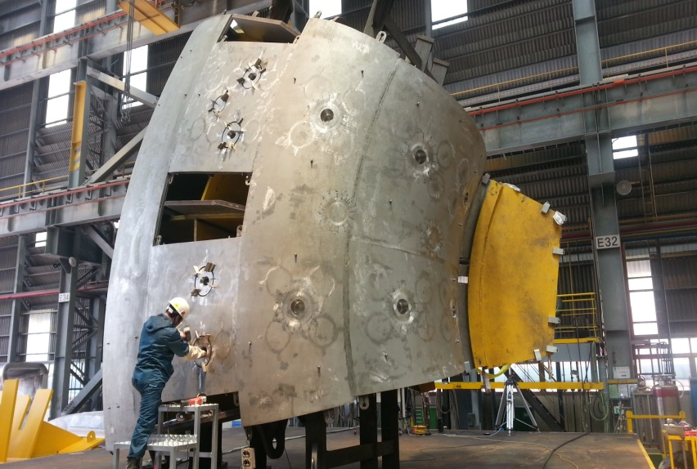
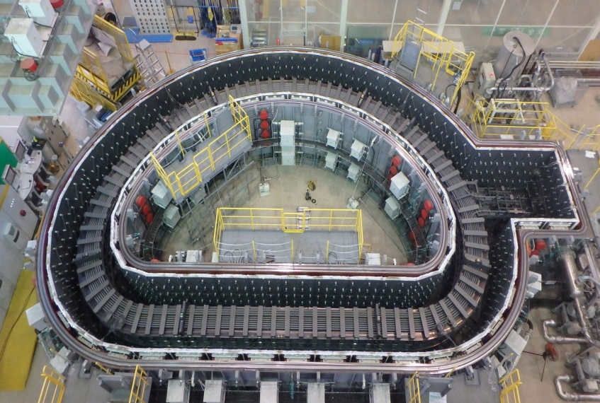
Priorities for future work
ITER under Construction
ITER Site 2015
ITER Tokamak Complex
Manufacturing progress
Korea
Japan

Slide 14
Governance structure
Control of the Programme is vested in the Executive Committee
Executive Committee consists of at least one and no more than three members designated by each Contracting Party.
Coordination with the ITPA involves mainly the planning and implementation of joint experiments on multiple devices with prescribed parameter ranges and conditions in order to investigate specific high-priority physics issues for the ITER Project and DEMO concepts that would benefit from comparative studies.

Slide 15
Outreach and communication activities
Annual Reports to IEA
CTP-TPC website: http://ctp.jet.efda.org/lt/

Slide 16
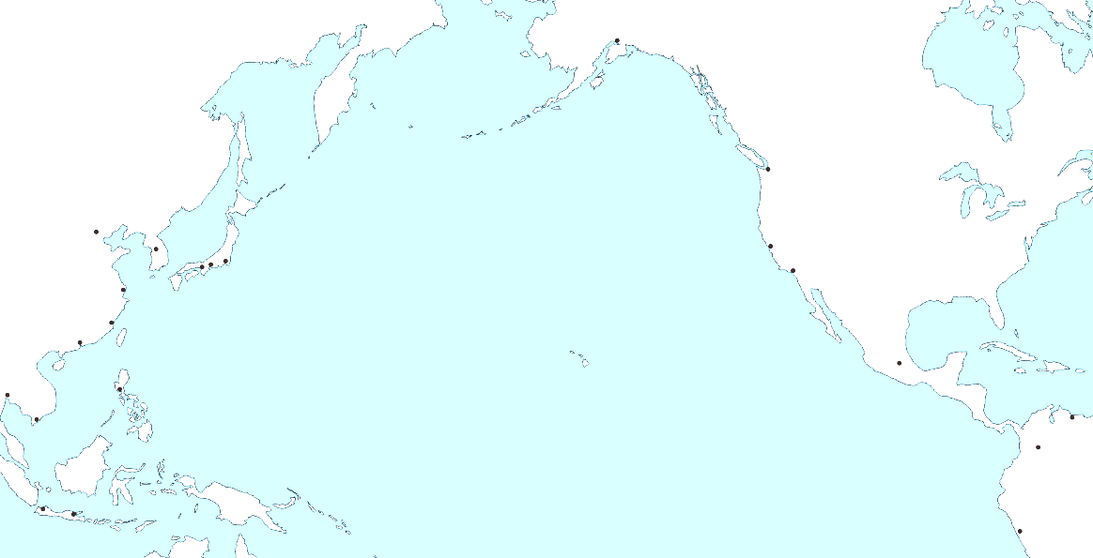
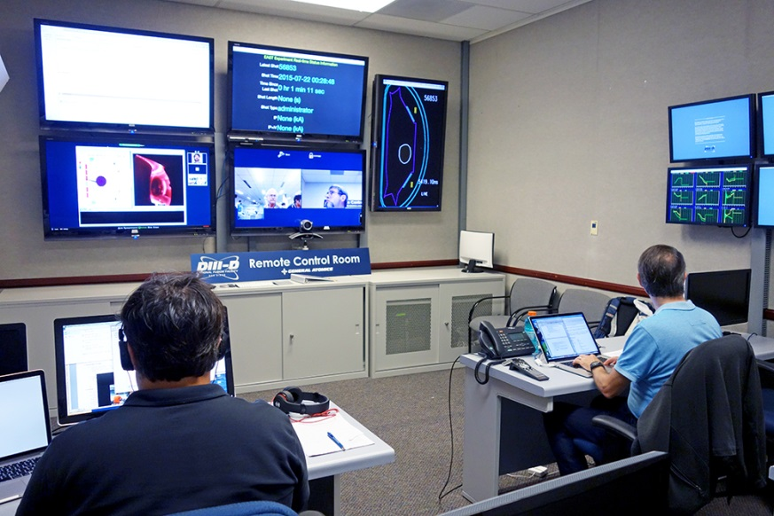
DIII-D: Vertical Control Experiments via Remote Operation of EAST 3rd Shift
GA Remote Control Room:
Display hardware and software to provide control room experience remotely
Real-time audio/video, streaming of data during shot, display of real-time boundary/ signal traces
GA Science Collaboration Zone:
Dedicated network and cyberspace for between-shot transfer of data to GA
DIII-D provides EAST data repository for all U.S. collaborators
Data mirror at GA serves all US collaborators
General Atomics Remote Control Room supports 3rd shift operation of EAST by US scientists
First full 3rd shift remote operation July 22 & 23:
Two 3rd shift periods (overnight in China)
Triggered vertical displacement events to assess growth rates, controllability
Validated EAST models & quantified stability effects of new passive plate/coil geometry
By FY 2017, experiments during EAST 3rd shift will enable US scientists to execute full EAST campaign each time EAST runs

